Slide 1
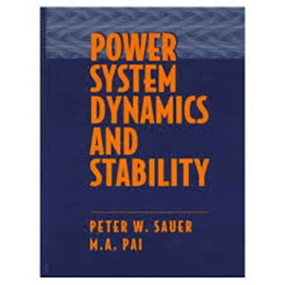
Notes Power System Dynamics and Stability
Prepared by
Karl Reinhard
reinhardke@gmail.com
Latest Update: 1 Feb 18
Supporting PhD Dissertation:
Power System Dynamic Modeling and Synchrophasor Measurements
©Jan ‘17
Based upon
Power System Dynamics and Stability
Peter W. Sauer and M.A. Pai
1st Edition
Contents
Variables and Definitions 1
Single Machine, Inf Bus, Balanced 3φ Transmission Line (T.L.) 4
Reference Frame Theory Prep to consider Unbalanced 3φ T.L. 6
Park’s Transformation for Resistive T.L. Component 8
Park’s Transformation for Inductive T.L. Component 9
Eqn Dev for Stator Components 10
Eqn Dev for T.L. Components 11
Modified Eqns for Ψ_{d} and Ψ_{q} formulation 13
Transmission Line Eqn Development 18
Single Machine, Inf Bus, Un-Balanced 3φ Transmission Line (T.L.) 20
Single Machine, Resistive Load (Raskin), Eqn Development 27
Single Machine, Resistive Load (Raskin), Eqn Development (ε = 0) 29

Slide 2
Variables and Definitions

Slide 3
Variables and Definitions (cont)

Slide 4
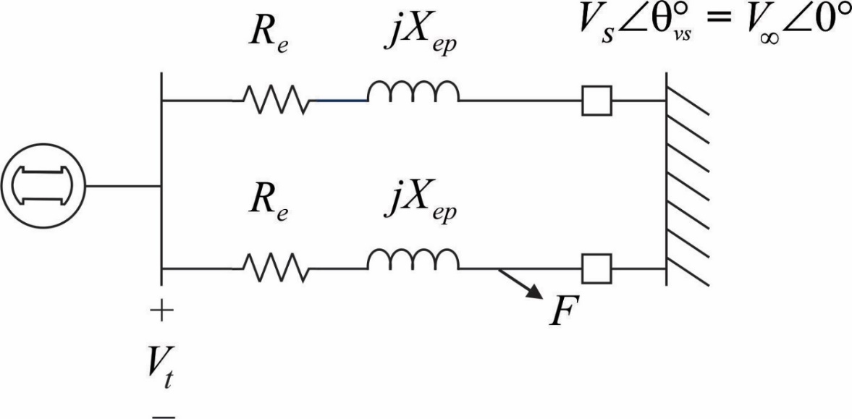
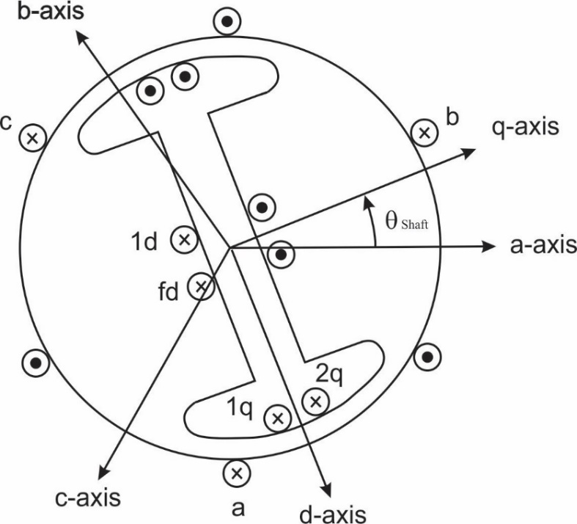
Single-Machine-Infinite Bus (Generator Notation)
Differentiate I_{d} and I_{q} to find explicit expression for evaluating V_{d} and V_{q}
3 Fast Dynamic States
Combined Flux terms incl. Machine & Trans. Line
(1)
(2)
(3)
11 not so fast Dynamic States
(4)
(5)
(6)
(7)
(8)
(9)
Excitation System
(10)
Main Exciter
(11)
Stabilizing Transformer
(12)
Pilot Exciter
6 Algebraic States
Mechanical Power System
(13)
Single Stage Turbine Model
(15)
(14)
Governor Model *
P_{SV} = Steam Valve Psn ( Pressure)
P_{C} = Power change setting
P_{C} = 0 when Open Ckt
R_{D} = Speed Droop Regulation Qty
ε = 2π (60) retained to preserve governor function
(16)
(17)
(18)
(19)
(20)

Slide 5
Algebraic Steps leading to eqns (5.51.3) and (5.52.3)

Slide 6
Single-Machine-Infinite Bus (Generator Notation)
3φ Breaker Opening – Referring R_{e} and X_{ep} into Rotor Frame
3 Fast Dynamic States
(1)
(2)
(3)
Reference Frame Theory
3 Fast Dynamic States – Unbalanced Conditions
(Note: Unbalanced TL conditions do not allow combining machine and TL terms into compact Ψ_{de} terms as in 5.42 – 5.44)
(1)
(2)
(3)

Slide 7
6 Algebraic States
(15)
(16)
(17)
(19)
(20)

Slide 8
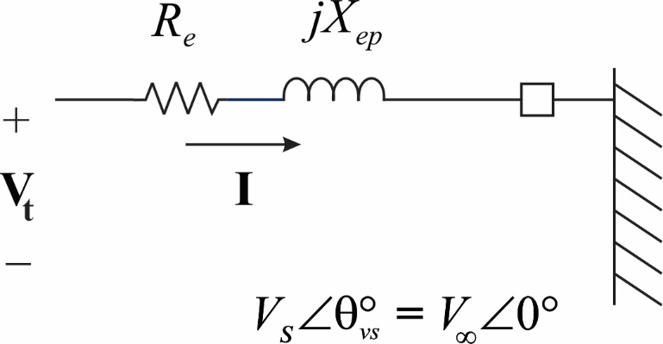
Park’s Transformation – Resistive Component
Lumped Parameters
Krause:
Except for isolated operation, it is convenient for analysis and interpretation purposes to related the SM rotor position to a reference voltage (or to another machine in a multiple machine system). The rotor angle, δ , is defined as the electrical angle displacement between the rotor and its terminal voltage. (p207)

Slide 9
Park’s Transformation – Inductive Component
0

Slide 10
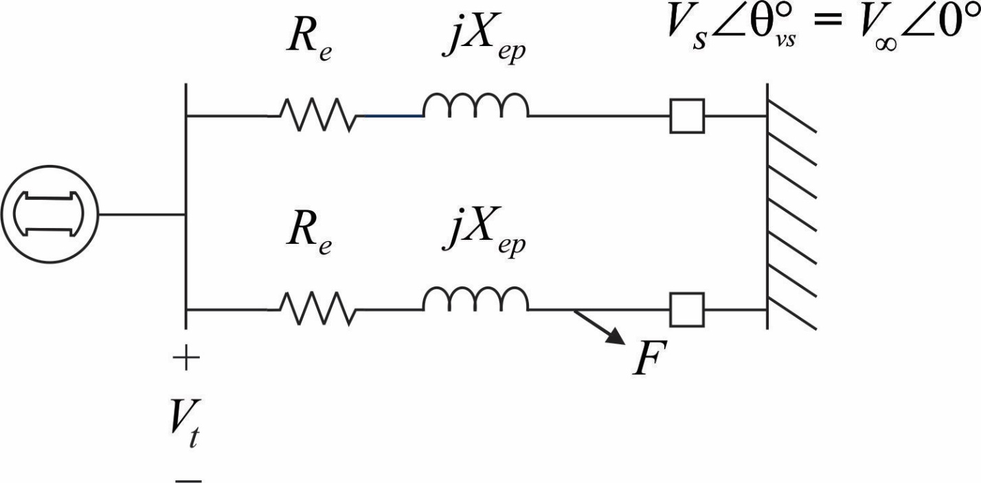

Equation Development
Stator Components:
(3.1)
(3.2)
(motor current notation)
(3.3)
Apply Park Transformation to refer “stator frame”
variables and constituent relations to “rotor frame” :
(3.17)
(3.18)
(3.19)
(motor current notation
via ‘-’ in scaling factor)
(3.148)
(3.149)
(3.150)
Note the dqo Transformation eliminates ψ_{o} term in the dqo frame

Slide 11
Equation Development
Transmission Line Components:
(3.27)
(3.28)
(3.29)
Apply Park Transformation to refer TL “stator frame”
variables and constituent relations to “rotor frame” :
TL treated as lumped parameters
with mutual cross inductance
0
(3.17)
(3.18)
(3.19)

Slide 12
Equation Development
Transmission Line Components (cont) :
6 Algebraic States
(5.59.2)
(5.60.2)
The ‘–’ arises because the scaling converts ‘motor’ notation;
however, the transmission line sign convention is preserved…
( Eqns 5.61 & 5.62)
Park Transform of Balanced 3φ X is diagonal
Distinguishing eqns 5.59 & 5.59.2 and 5.60 & 5.60.2

Slide 13
MODIFIED
(5.59.2)
(1)
(5.60.2)
(2)
(3)
(1)
(2)
(3)
(3.150.1)

Slide 14
MODIFIED

Slide 15
MODIFIED
(1)
(2)
(3)

Slide 17
(1)
(2)
(3)

Slide 18
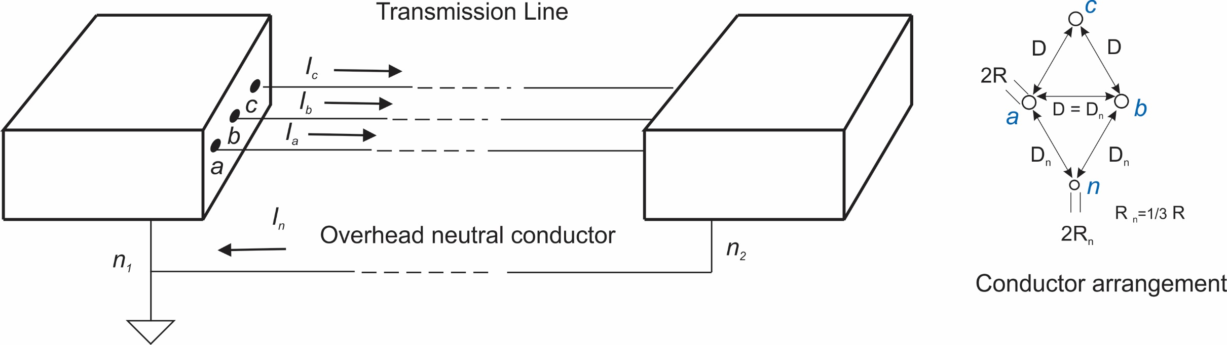

Slide 19
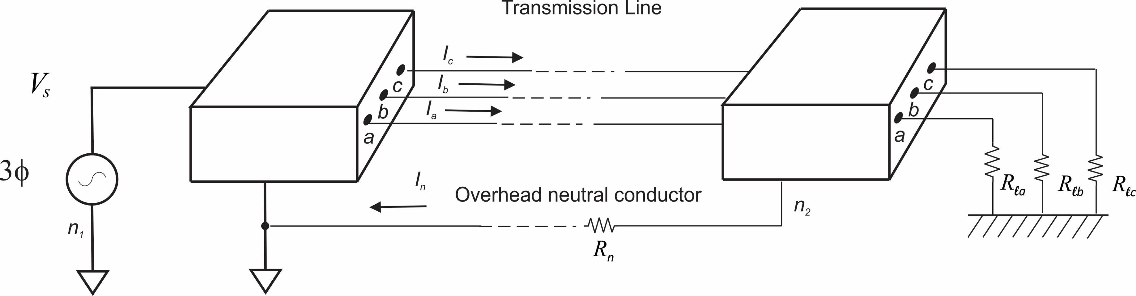

Slide 20
(Note the similarity of off-diagonal terms to balanced transmission line under normal conditions. Balanced neutral →
Phase Currents sum to 0 Elgerd, Sect. 6-4-7, p 182. )
Compute Transmission Line Parameters for simulated case based upon Kundur’s Typical Transmission Lines, Table 6
Assume that D (phase conductor separation) is 5 meters; Determine R (conductor radius) to obtain Kundur’s value.
Assume that D = D_{n} (effective distance from neutral to phase conductors – achieved via transposition)
Assume that R_{n} = 1/3 R
Nom Voltage: | 230 KV
R (Ω/km) | .050
X_{L} = ωL (Ω/km) | .488
B_{c} = ωC (μs/km) | 3.371
Z_{c} = (Ω) | 380
SIL (MW) | 140

Slide 21
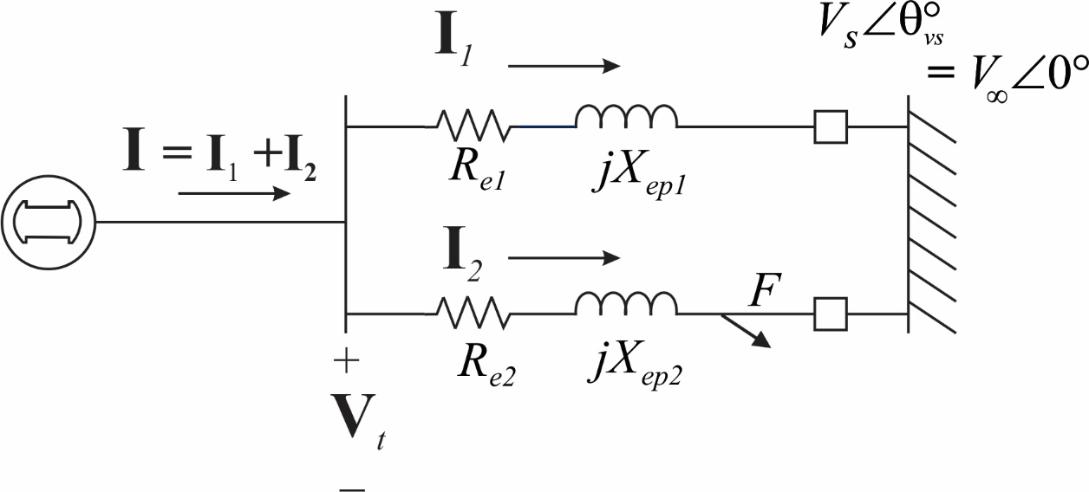
SYNCHRONOUS MACHINE – INFINITE BUS (Generator Notation)
Explicitly Modeled || Transmission Lines
3φ Breaker Opening – Referring R_{e} and X_{ep} into Rotor Frame
Updated 17 Oct 16
Font colors updated 8 Dec 16
3 Fast Dynamic States
(1)
(2)
(3)
11 not so fast Dynamic States
(4)
(5)
(6)
(7)
(8)
(9)
Excitation System
(10)
Main Exciter
(11)
Stabilizing Transformer
(12)
Pilot Exciter
Mechanical Power System
15 Algebraic States
(13)
Single Stage Turbine Model
(14)
Governor Model *
P_{SV} = Steam Valve Psn ( Pressure)
P_{C} = Power change setting
P_{C} = 0 when Open Ckt
R_{D} = Speed Droop Regulation Qty
ε = 2π (60) retained to preserve governor function
(18)
(19)
(20)
(15)
(16)
(17)

Slide 22



SYNCHRONOUS MACHINE – INFINITE BUS (Generator Notation)
Explicitly Modeled || Transmission Lines
3φ Breaker Opening – Referring R_{e} and X_{ep} into Rotor Frame
Updated 17 Oct 16
Font colors updated 8 Dec 16
3 Fast Dynamic States
$$\left(5.42.2)\right.$$
$$\left(5.43.2) \right.$$
$$\left(5.44.2)\right.$$
11 not so fast Dynamic States
Excitation System
(10)
Main Exciter
(11)
Stabilizing Transformer
(12)
Pilot Exciter
Mechanical Power System
15 Algebraic States
(13)
Single Stage Turbine Model
(14)
Governor Model *
P_{SV} = Steam Valve Psn ( Pressure)
P_{C} = Power change setting
P_{C} = 0 when Open Ckt
R_{D} = Speed Droop Regulation Qty
ε = 2π (60) retained to preserve governor function
(18)
(19)
(20)
(15)
(16)
(17)

Slide 23
(26)
(27)
(28)
(21)
(22)
(23)
KVL Equation TL 1 (Updated 20 Oct 16)
(18)
(19)
(5.59.3)
Null Source …
… Null Source
(20)
(5.60.3)
Null Source …
… Null Source
(25)
(5.33)

Slide 24
INDUCTOR:
Null Source INDUCTOR:
(1)
INDUCTOR:
(2)
Null Source INDUCTOR:
0
0
Σ = 0

Slide 25
25
Inductor, Transformer V
P
V_{term}
Q
V_{R}
Model Scaling
R
Inductor, Speed V
scaled ω
S

Slide 26
KVL Equation TL 2
(19.1)
(5.59.4)
(20.1)
(5.60.4)
(25.1)
(5.33)
(30)
(31)
(24) (Theta shaft)
(21.1)
(22.1)
(23.1)

Slide 27
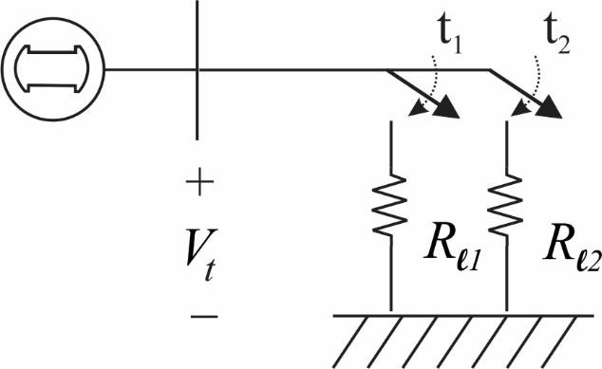
Single-Machine-Resistive Load (Raskin) model, Bus (Generator Notation) Full Model (e≠ 0)
3 Fast Dynamic States
(1)
(2)
(3)
11 not so fast Dynamic States
(4)
(5)
(6)
(7)
(8)
(9)
Excitation System
(10)
Main Exciter
(11)
Stabilizing Transformer
(12)
Pilot Exciter
6 Algebraic States
Mechanical Power System
(13)
Single Stage Turbine Model
(15)
(14)
Governor Model *
P_{SV} = Steam Valve Psn ( Pressure)
P_{C} = Power change setting
P_{C} = 0 when Open Ckt
R_{D} = Speed Droop Regulation Qty
ε = 2π (60) retained to preserve governor function
(16)
(17)
(18)
(19)
(20)

Slide 28
Single-Machine-Resistive Load (Raskin) model, Bus (Generator Notation) Full Model (e≠ 0) and open ckt (I’s = 0)
3 Fast Dynamic States
(1)
(2)
(3)
11 not so fast Dynamic States
(4)
(5)
(6)
(7)
(8)
(9)
Excitation System
(10)
Main Exciter
(11)
Stabilizing Transformer
(12)
Pilot Exciter
6 Algebraic States
Mechanical Power System
(13)
Single Stage Turbine Model
(15)
(14)
Governor Model *
P_{SV} = Steam Valve Psn ( Pressure)
P_{C} = Power change setting
P_{C} = 0 when Open Ckt
R_{D} = Speed Droop Regulation Qty
ε = 2π (60) retained to preserve governor function
(16)
(17)
(18)
(19)
(20)

Slide 29
Single-Machine-Resistive Load (Raskin) model, Bus (Generator Notation) -- Reduced Model (e = 0 )
3 Fast Dynamic States
(1)
(2)
(3)
11 not so fast Dynamic States
(4)
(5)
(6)
(7)
(8)
(9)
Excitation System
(10)
Main Exciter
(11)
Stabilizing Transformer
(12)
Pilot Exciter
6 Algebraic States
Mechanical Power System
(13)
Single Stage Turbine Model
(15)
(14)
Governor Model *
P_{SV} = Steam Valve Psn ( Pressure)
P_{C} = Power change setting
P_{C} = 0 when Open Ckt
R_{D} = Speed Droop Regulation Qty
ε = 2π (60) retained to preserve governor function
(16)
(17)
(18)
(19)
(20)

Slide 30
Single-Machine-Resistive Load (Raskin) model, Bus (Generator Notation) -- Reduced Model (e = 0 ) and open ckt (I’s = 0)
3 Fast Dynamic States
(1)
(2)
(3)
11 not so fast Dynamic States
(4)
(5)
(6)
(7)
(8)
(9)
Excitation System
(10)
Main Exciter
(11)
Stabilizing Transformer
(12)
Pilot Exciter
6 Algebraic States
Mechanical Power System
(13)
Single Stage Turbine Model
(15)
(14)
Governor Model *
P_{SV} = Steam Valve Psn ( Pressure)
P_{C} = Power change setting
P_{C} = 0 when Open Ckt
R_{D} = Speed Droop Regulation Qty
ε = 2π (60) retained to preserve governor function
(16)
(14.1)
(17)
(18)
(Ransick modeling problem statement)
V_{d} and V_{q} are not defined for open Ckt (I’s = 0) and (e = 0);
No P or Q powerflow and hence no reference angle
(19)
(20)

Slide 31
Single-Machine-Resistive Load (Raskin) model, Bus (Generator Notation) -- Reduced Model (e = 0 and Open Circuit (I’s = 0 ) and Open Ckt assumptions V_{d}, ψ_{qe} = 0 )
3 Fast Dynamic States
(1)
(2)
(3)
11 not so fast Dynamic States
(4)
(5)
(6)
(7)
(8)
(9)
Excitation System
(10)
Main Exciter
(11)
Stabilizing Transformer
(12)
Pilot Exciter
6 Algebraic States
Mechanical Power System
(13)
Single Stage Turbine Model
(15)
(14)
Governor Model *
*(PC = 0 when Open Ckt)
(16)
(17)
(18)
(19)
(20)

